Slide 1
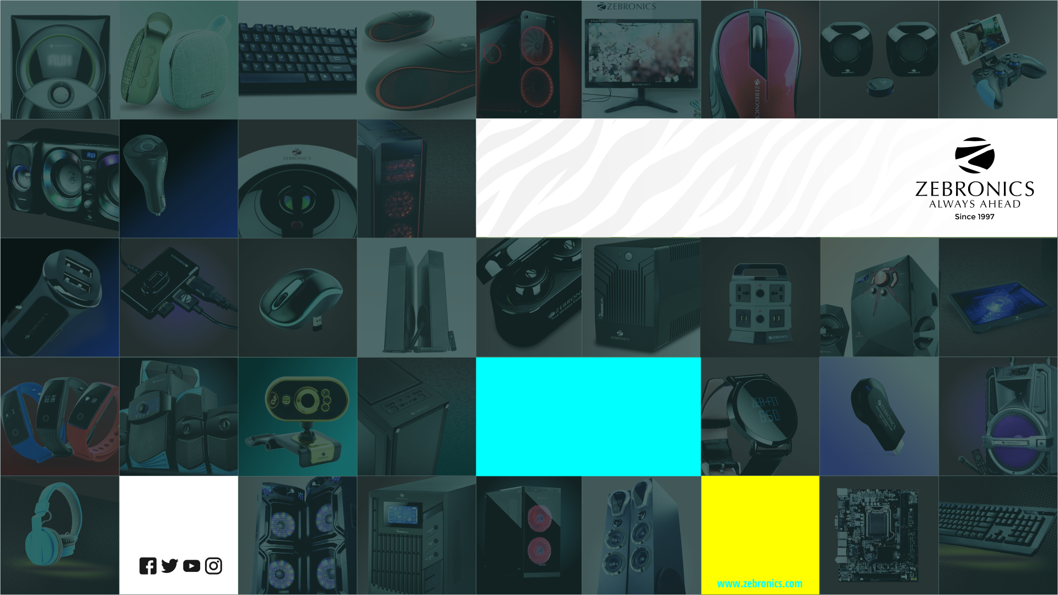

Slide 2

Origin
Started in the year 1997, with a vision to provide world class products, which are great on design and performance yet easy on pocket, that every household in the country can afford.

Slide 3
Increase in footprint
31 Branches
128+ service centres

Slide 4
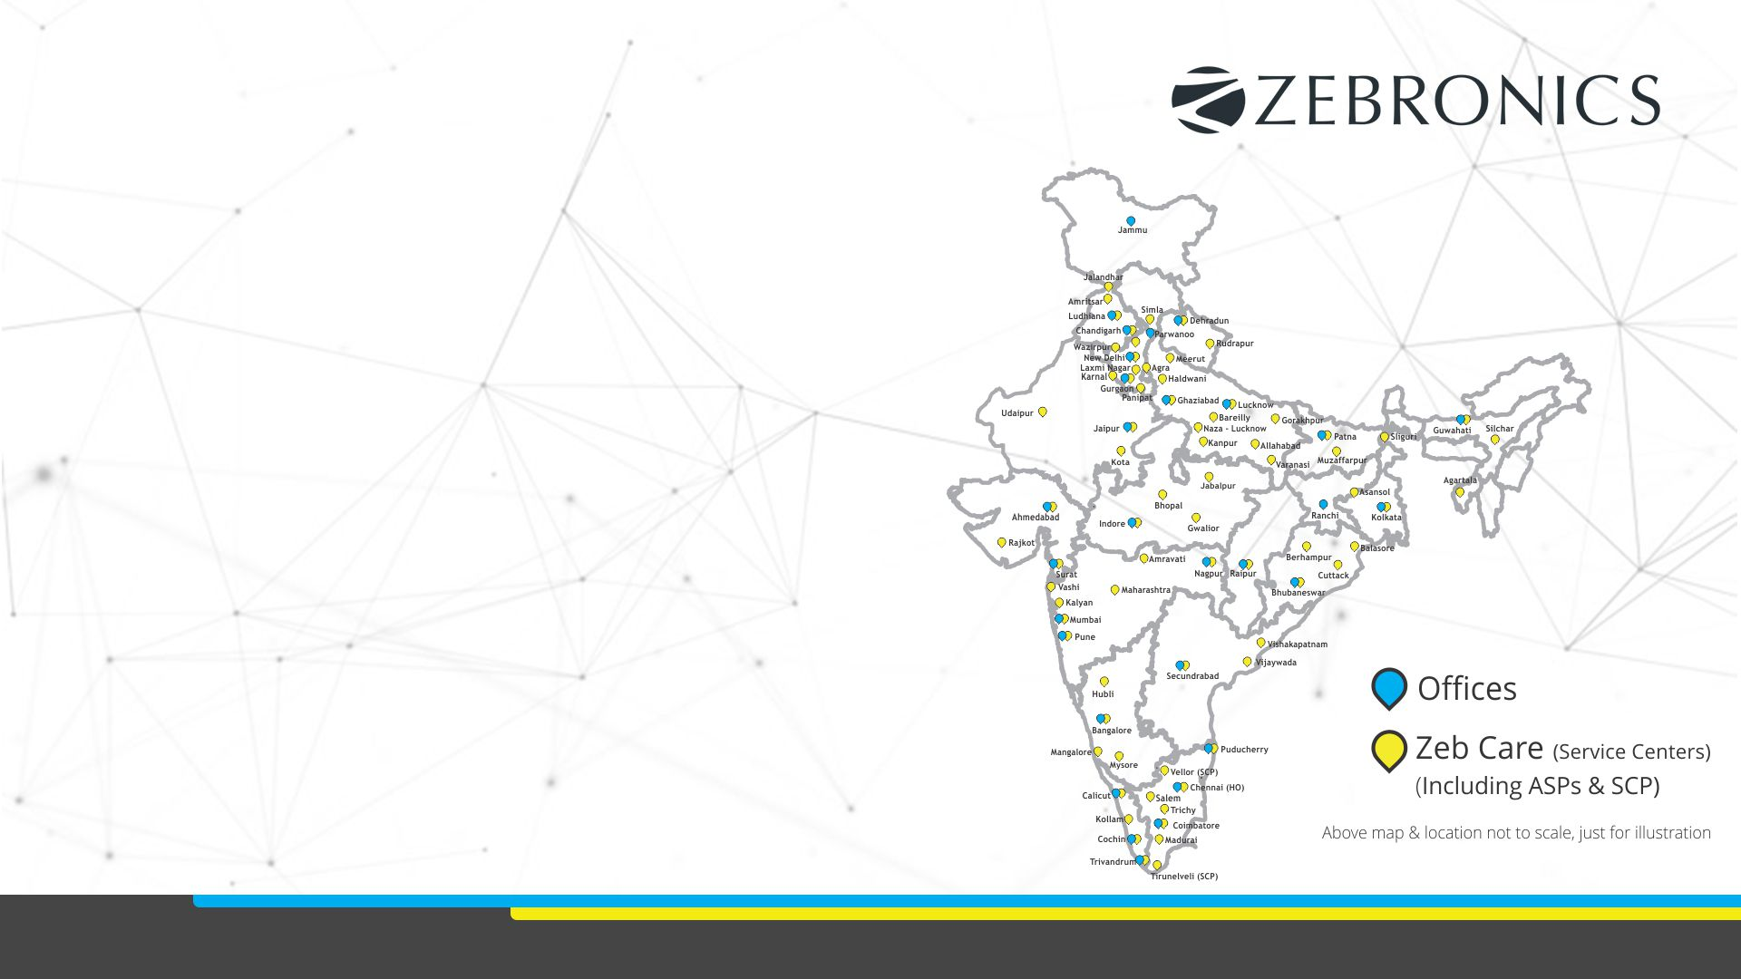
Increase in footprint

Slide 5
Today
1200+ Employees
a Zebronics
product is sold every
6 secs
50,000+ Retail partners

Slide 6
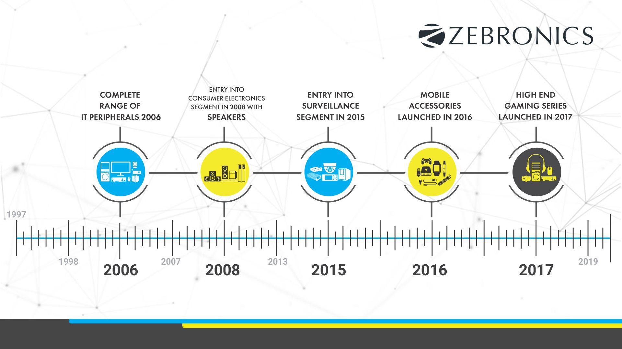
Expansion of products

Slide 7
Core strength
Logistics - World class supply chain management.
Storage - Centralised stock control with warehouse at branches.
Reliability - Providing a edge over competition in after sales and service.
Channel network - Vast range of dealers and distributors, availability of products even at farthest corner of the country.
Work force - Experienced and dynamic team.
Sales - A Stellar sales team, taking the company to new heights.
Finance - Strong finance team with proper control of accounts and credit management system.
Marketing - Innovative marketing strategies.

Slide 8



A modern brand
Complete rebranding early 2015

Slide 9
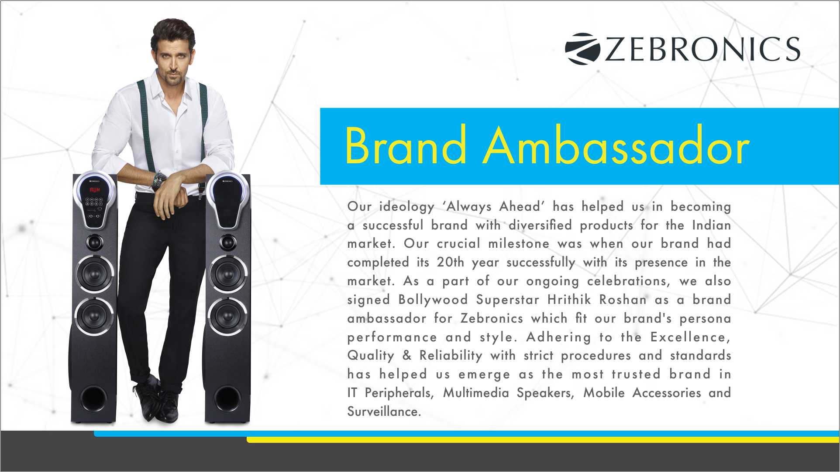
Brand Ambassador

Slide 10
Products
IT and Gaming Products
Audio Solutions
Mobile and lifestyle accessories
Surveillance

Slide 11
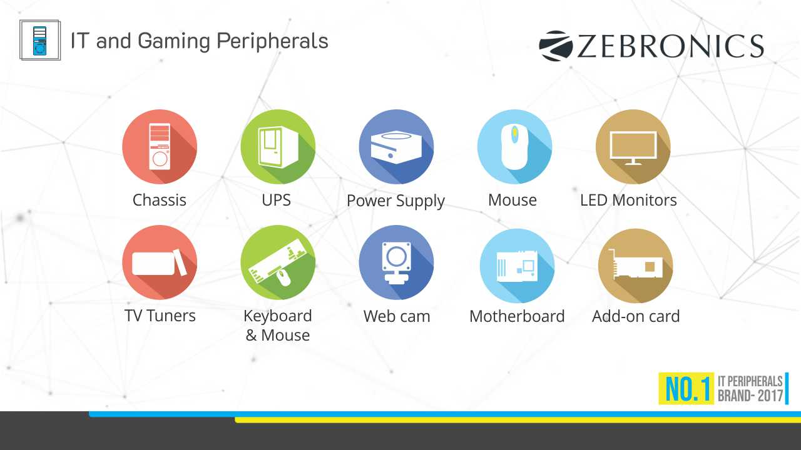

Slide 12
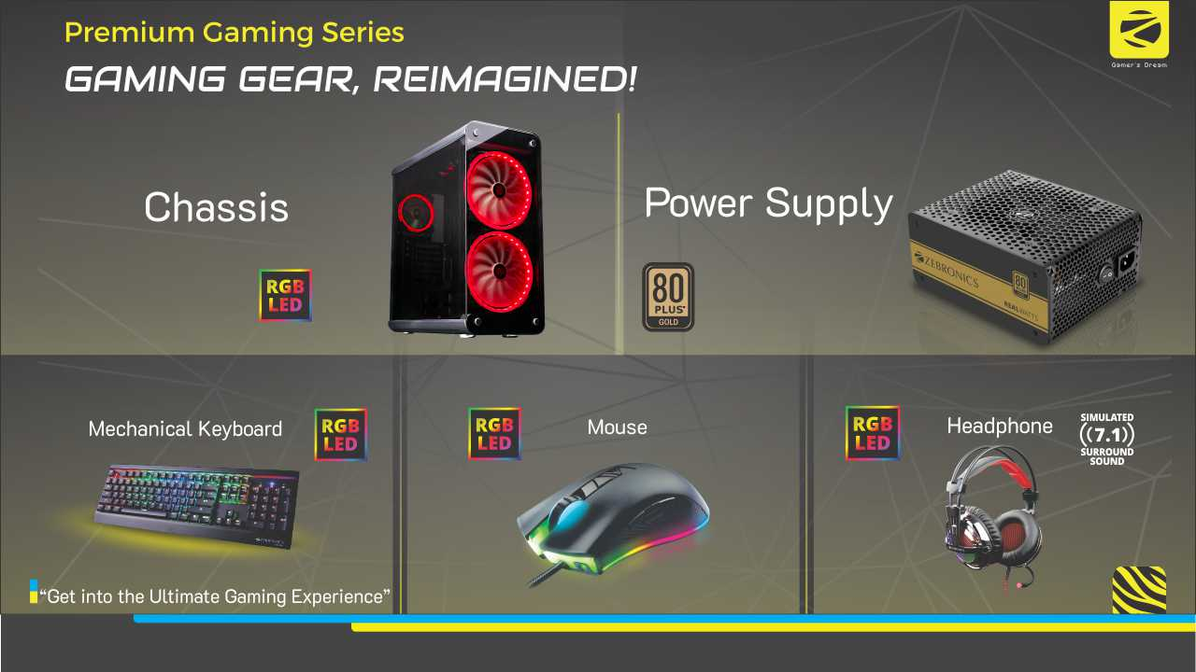

Slide 13
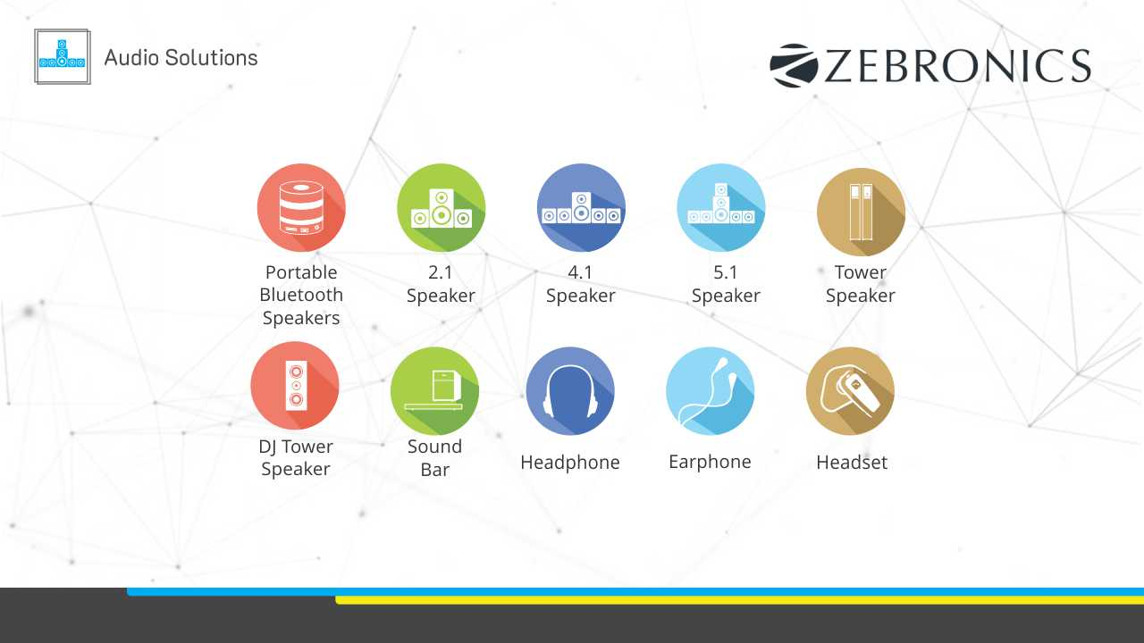

Slide 14
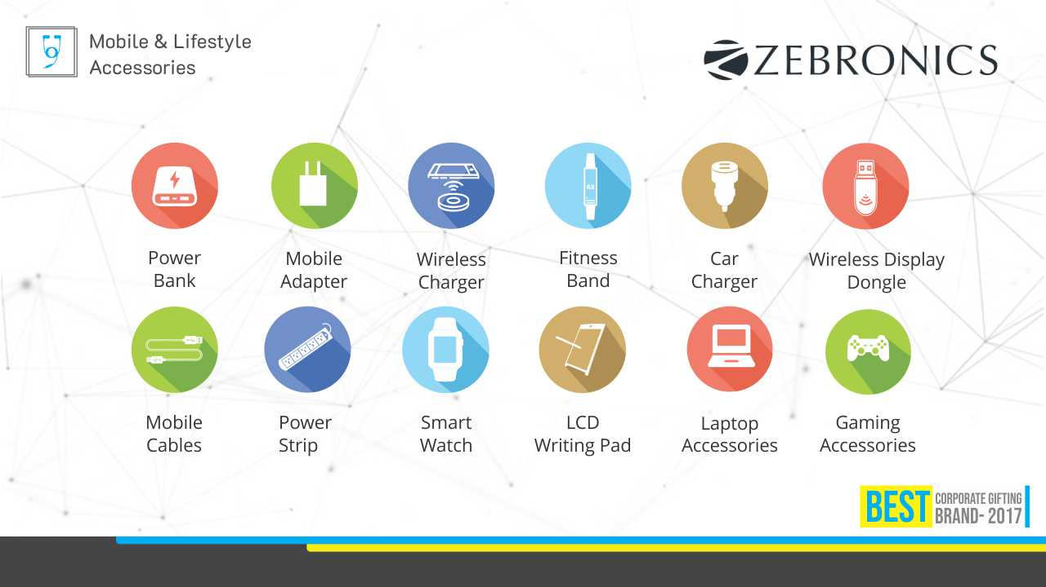

Slide 15
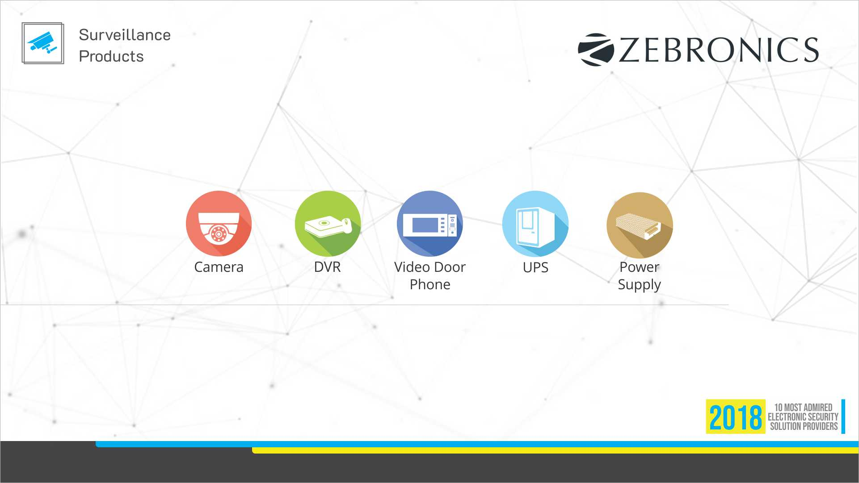

Slide 16
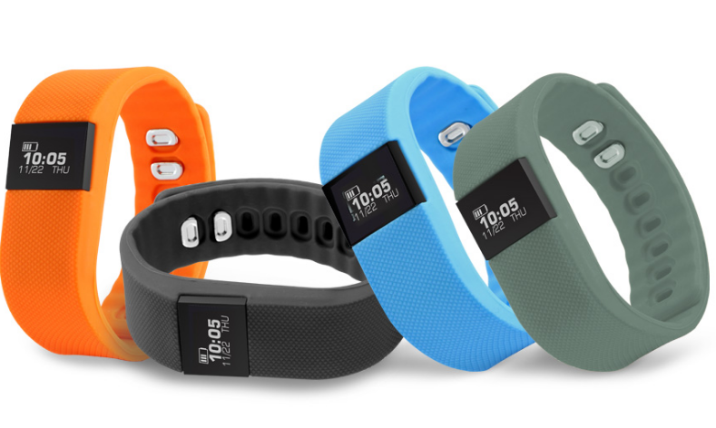
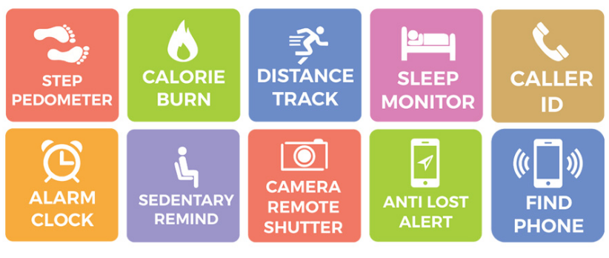
Smart Fitness Band
ZEB-FIT 100
Features
Specification
Time Display
Step Pedometer
Calorie burnt count
Distance tracking
Sleep monitoring
Caller ID
Alarm Clock
Sedentary reminder
Remote camera shutter
Call, SMS and third party app message notification.
Anti lost alert
Wrist sense
Find Phone
Support: IOS 7.1 & Above/ Android 4.4 & Above*
Vibration: Yes
Water Resistant: Yes (Not suitable for swimming or diving)
Screen Size & Type: 1.24cm, OLED
Bluetooth: v4.0
Control: 1 key on left
Data Storage: 7 days
Battery: Built-in rechargeable battery
Standby Time: 15 days & above
Charge Time: 1 hour
Color: Blue, Black, Orange
Strap: High quality silicone
Product Dimension
Core: 41.6 x 20 x 11.8 mm
Strap: 250mm
Net Weight: 25.8g
MRP: ₹1414

Slide 17
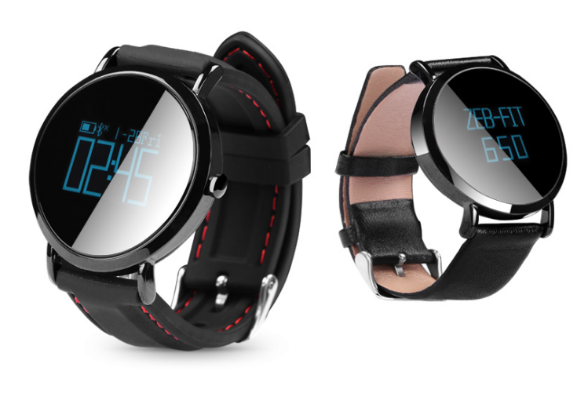

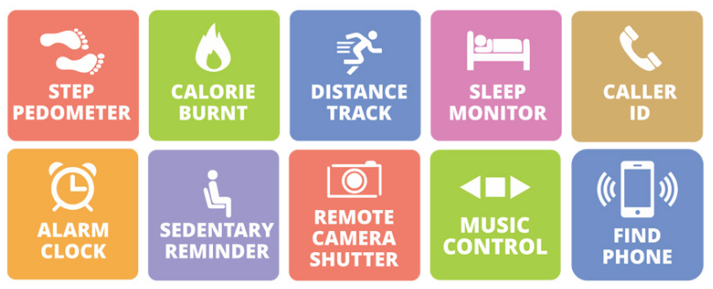
Smart Fitness Band
ZEB-FIT 650
Features
Specification
Round face
Heart Rate monitor
Time Display
Pedometer
Calorie burnt
Distance tracking
Sleep monitoring
Caller ID
Alarm Clock
Sedentary reminder
Remote camera shutter
Call, SMS and third party app message notification
Music Control
Wrist sense
Find Phone
Support: iOS 8.0 & Above / Android 4.4 & Above*
Vibration: Yes
Water Resistant: Yes (Not suitable for swimming or diving)
Screen Size & Type: 2.4cm, OLED
Bluetooth: BLE 4.0
Control : 1 key on right & Touch display
Data Storage: 3 days
Battery: 100mAh, Built-in rechargeable
Standby Time: 25-30 days
Charge Time: 2 hours
Color: Black
Strap: Leather Finish / silicone
Product Dimension
Core (Dia x H) 40 x 11.5 mm
Strap (L x B) Long strap: 115 x 20mm; Short strap: 84 x 20mm
Net Weight Leather 40g / Silicone 50.7g

Slide 18
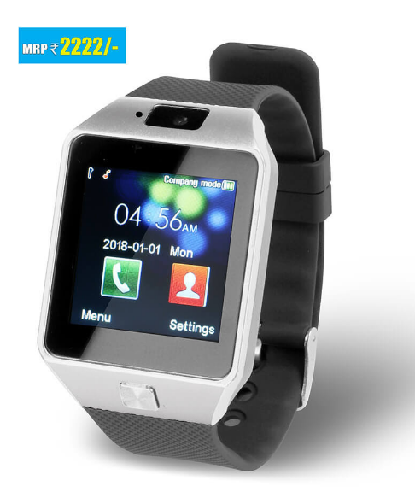
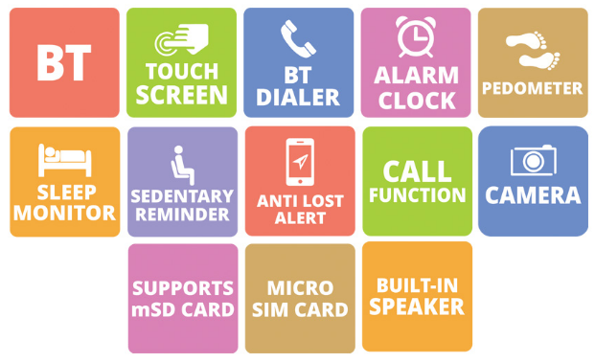
Smart Fitness Band
ZEB-FIT 650
Features
Specification
Wireless BT
Touch screen
Supports mSD Card
Supports micro Sim Card
Call and SMS
BT Dialer
Anti-Lost
Pedometer
Sleep Monitor
Sedentary reminder
Camera
G-Sensor
Screen Size: 3.9cm (1.54")
Resolution: 240 x 240pixel
Vibration: Yes
Frequency band: 850/900/1800/1900 MHz
RAM: 32MB
ROM: 32MB
Max Supported Micro SD memory size: 32GB
Contacts: Yes
BT Version: v3.0
G-Sensor: Yes
Language : English, Hindi, Bengali
Alarm: Yes
Calculator : Yes
Battery Capacity: 410mAh
Speaker: Yes
Product Dimension (W x H x D) (Without Strap): 39 x 56 x 13 mm
Net. weight: 56g

Slide 19
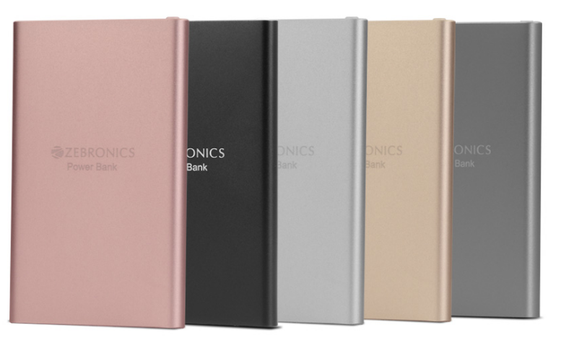

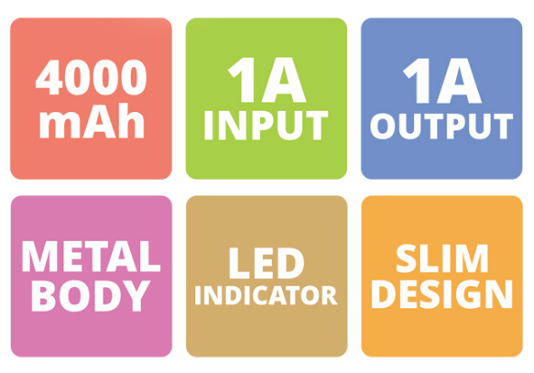
Power Bank
ZEB-PG4000A
Features
Specification
LED Indicator
Mobile/Tablet Compatible
Over Charge Protection
Overload Protection
Short Circuit Protection
Metal body finish
Slim & Compact
Battery Capacity: 4000mAh
Input :DC 5V 1A
Output: DC 5V 1A
No. of Output port: 1
Charging Time: 4-5 hours
Dimension (W x D x H): 68 x 10 x 110 mm
Net Weight: 126g

Slide 20
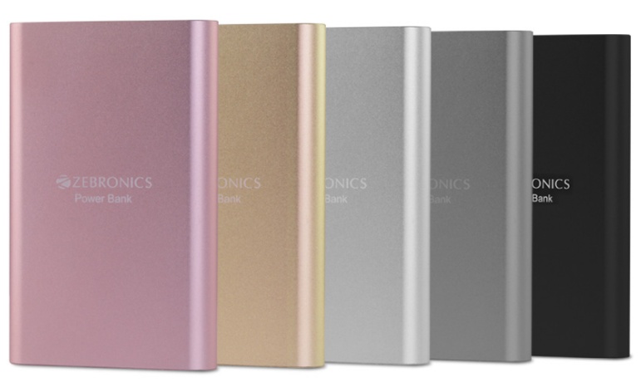

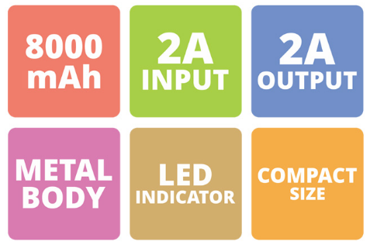
Power Bank
ZEB-PG8000A
Features
Specification
LED Indicator
Mobile/Tablet Compatible
Over Charge Protection
Overload Protection
Short Circuit Protection
Metal body finish
Compact size
Battery Capacity: 8000mAh
Input: DC 5V 2A
Output: DC 5V 2A
No. of Output port: 1
Charging Time: 4-5 hours
Dimension (W x D x H): 70 x 16 x 110 mm
Net Weight: 204g

Slide 21
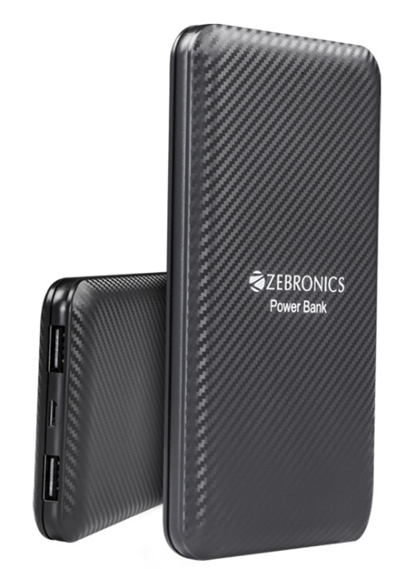

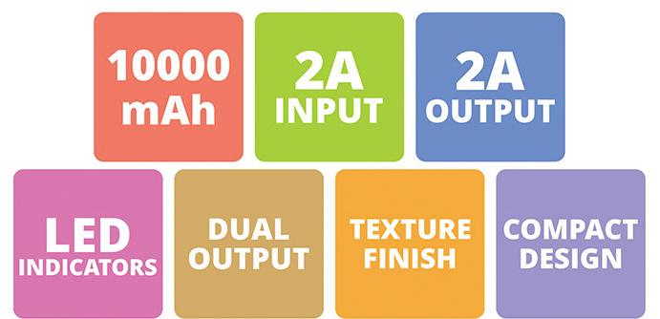
Power Bank
ZEB-PB10000
Features
Specification
LED Indicators
Dual Output
Mobile/Tablet Compatible
Texture Finish
Over Charge Protection
Overload Protection
Short Circuit Protection
Auto Recovery
Battery Capacity: 10000mAh
Input: 5V 2A
Output 1: 5V 2A
Output 2: 5V 2A
No. of Output port: 2
Charging Time: 5-6 hours
Dimension: 130 x 70 x 15.3mm
Net Weight: 195g

Slide 22
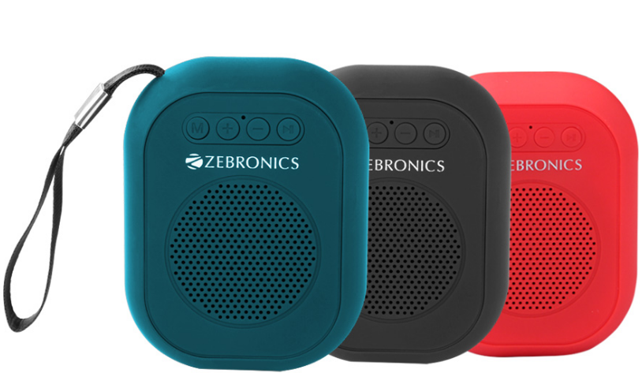
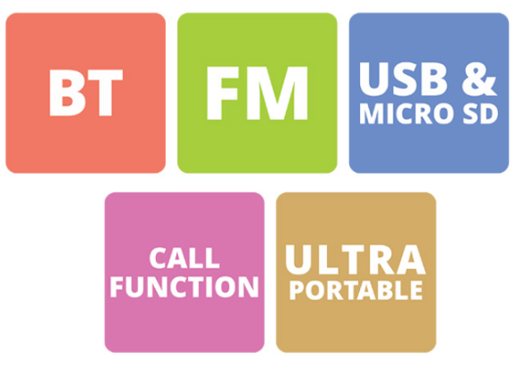
Portable BT Speaker
ZEB-SAGA
Features
Specification
Wireless BT
Supports USB & Micro SD card
Media / volume control
Call Function
Built-in FM Radio
Built-in Rechargeable Battery
Output Power (RMS): 3W
BT Version: 4.2
Driver Size: 50.8mm (2")
Speaker Impedance: 3Ω
Frequency Response: 100Hz-20kHz
S/N Ratio: ≤63dB
Charging time: 2 - 3 hours
Playback time: 1.5 hours (Max Volume)
Product Dimension: 37 x 68 x 87 mm
Net. Weight: 108g
MRP: ₹777

Slide 23
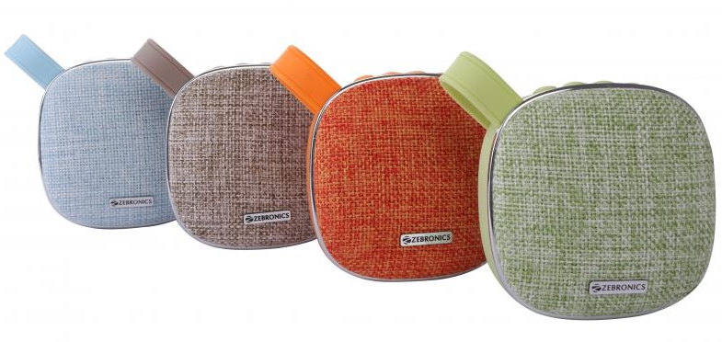
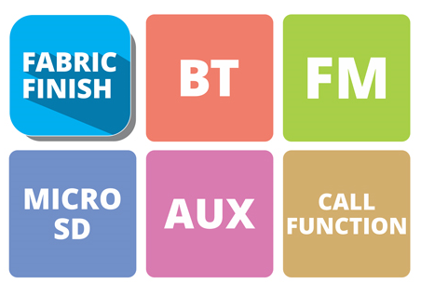
Portable BT Speaker
ZEB-PASSION
Features
Specification
Wireless BT
Supports Micro SD card
Built-in FM Radio
AUX Input
Call Function
Media / volume control
Fabric Finish
Built-in Rechargeable Battery
Output Power (RMS): 3W
BT Version: 5.0
Driver Size: 5.08cm (2")
Speaker Impedance: 4Ω
Frequency Response: 100Hz - 20kHz
S/N Ratio: ≥85dB
Max Supported Micro SD memory size: 32GB
Supported Audio formats: MP3
Charging time: 1-2 hrs
Playback time: 3 hrs*
Product Dimension (W x D x H): 86 x 42.50 x 87 mm
Package Dimension (W x D x H): 100 x 48 x 106 mm
Net. Weight: 162g
MRP: ₹999

Slide 24
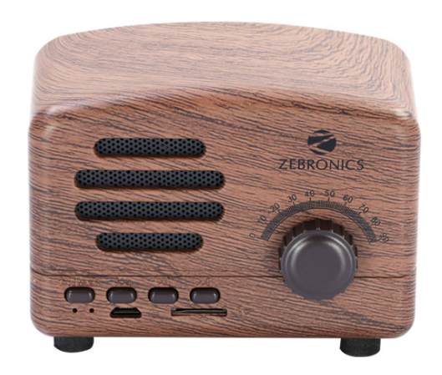
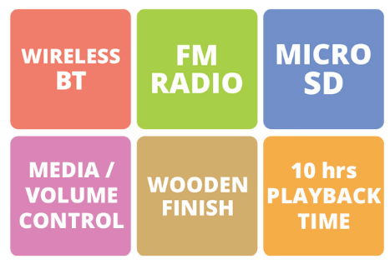
Portable BT Speaker
ZEB-GLORY
Features
Specification
Wireless BT
Supports mSD card
Built-in FM Radio
Media / Volume control
Built-in Rechargeable battery
Output Power (RMS): 4W
BT Version: 4.2
Driver Size: 40mm
Speaker Impedance: 4Ω
Frequency Response: 150Hz-18kHz
S/N Ratio: ≥70dB
Max Supported mSD memory size: 32GB
Supported Audio formats: MP3
Charging time: 1.5-2 hrs
Playback time: 10hrs
Product Dimension (W x D x H): 95 x 59 x 66 mm
Net. Weight: 220g
MRP: ₹1499

Slide 25
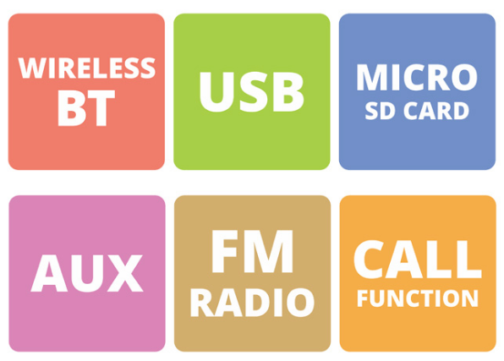
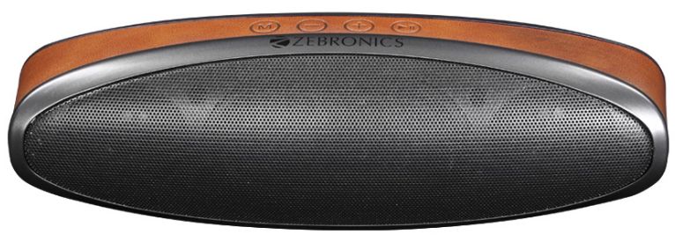
Portable BT Speaker
ZEB-VOGUE
Features
Specification
Wireless BT
Supports USB & Micro SD card
Built-in FM Radio
AUX Input
Media control
Dual Speaker
Call Function
Built-in Rechargeable Battery
Output Power (RMS): 3W x 2
BT Version: 4.2
Driver Size: 45mm x 2
Speaker Impedance: 3Ω
Frequency Response: 100Hz-20kHz
S/N Ratio: ≥80dB
Max Supported USB/Micro SD memory size: 32GB
Supported Audio formats: MP3
Charging time: 3-4 hours
Playback time: 5hrs
Product Dimension (W x D x H): 213 x 60.3 x 66.75 mm
Net. Weight: 354g
MRP: ₹1499

Slide 26
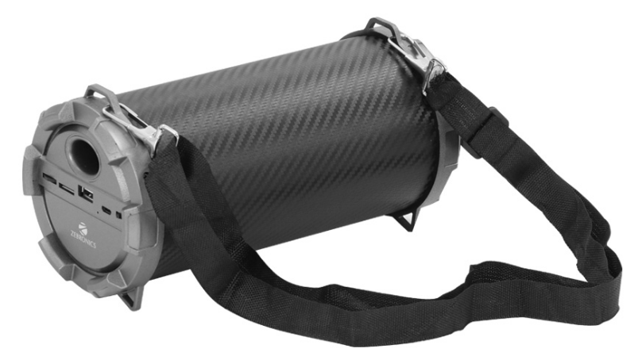
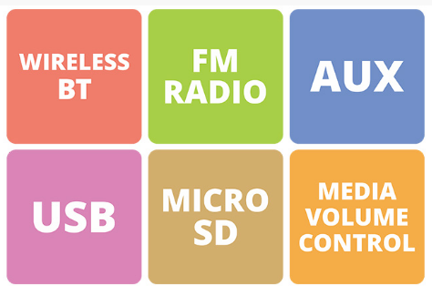
Portable BT Speaker
ZEB-BARREL
Features
Specification
MRP: ₹1599
Wireless BT
Supports USB & mSD card
Built-in FM Radio
AUX Input
Media / Volume control
Built-in Rechargeable battery
Output Power (RMS): 5W
BT Version: 4.1
Driver Size: 3 "
Speaker Impedance: 2Ω
Frequency Response: 100Hz-20kHz
S/N Ratio: ≥80dB
Max Supported USB/mSD memory size: 32GB
Supported Audio formats: MP3
Charging time: 2 - 3 hrs
Playback time: 2.5 hrs (max volume)
Product Dimension (W x D x H): 100 x 215 x 110mm
Net. Weight: 300g

Slide 27
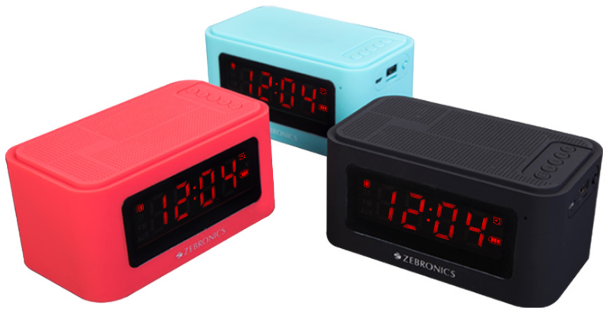
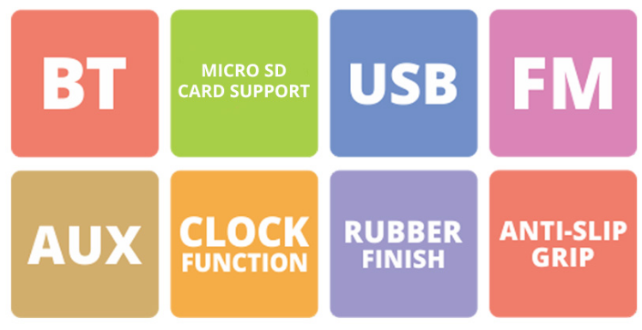
Portable BT Speaker
ZEB-CLOSIC 2
MRP: ₹1599
Features
Specification
Wireless BT
Supports USB/ Micro SD card
AUX Input
Media / volume control
Built-in FM Radio
Clock Function
LED Display
Built-in Rechargeable Battery
Output Power (RMS): 5W
BT Version: v3.0
Driver Size: 52mm
Speaker Impedance: 4Ω
Frequency Response: 20Hz - 20kHz
S/N Ratio: ≥80dB
Max Supported USB/mSD memory size: 32GB
Supported Audio formats: MP3
Charging time: 5-6 hrs
Playback time: 4 hrs
Product Dimension: 132 x 75 x 68 mm (W x D x H)
Net. Weight: 332g

Slide 28
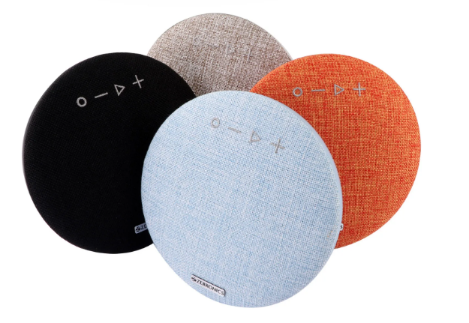
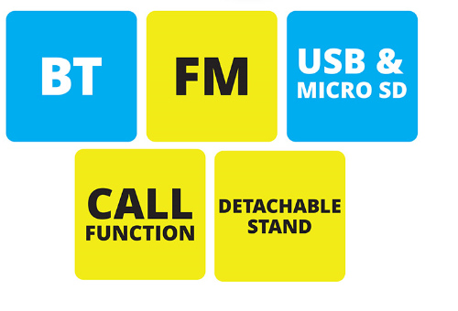
Portable BT Speaker
ZEB-MAESTRO
Features
Specification
Wireless BT
Supports USB/ Micro SD card
Fabric Finish
AUX Input
Media / volume control
Built-in FM Radio
Built-in Rechargeable Battery
Output Power (RMS): 5W x 2
BT Version: 4.2
Driver Size: 50mm x 2
Speaker Impedance: 4Ω
Frequency Response: 100Hz-20kHz
S/N Ratio: ≥63dB
Max Supported memory size: 32GB (USB/mSD)
Supported Audio formats: MP3 (USB/mSD)
Charging time: 3hrs
Playback time: 2-3 hrs
Product Dimension: 190 x 48 mm (Dia x H)
Net. Weight: 568g
MRP: ₹1699

Slide 29
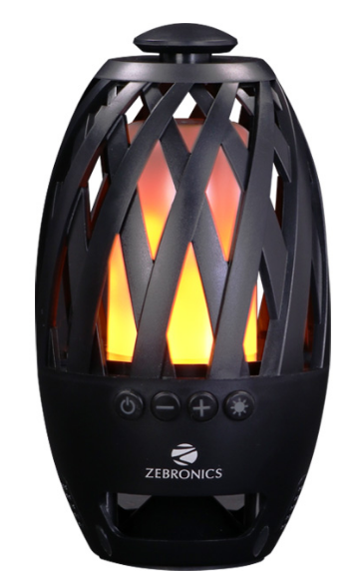
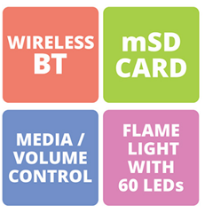
Portable BT Speaker
ZEB-ATOM
Features
Specification
Wireless BT
Supports mSD Card
Media control
Built-in Rechargeable Battery
Flame Light with 60 LEDs
Output Power (RMS): 3W
BT Version: 4.2
Driver Size: 50mm
Speaker Impedance: 4Ω
Frequency Response: 100Hz-20kHz
S/N Ratio: ≥ 75dB
Max Supported Micro SD memory size: 32GB
Supported Audio formats: MP3
Charging time: 3 hrs
Playback time: 2.5 hrs
Product Dimension (Dia x H): 100 x 179.2 mm
Net. Weight: 340g
MRP: ₹1899

Slide 30
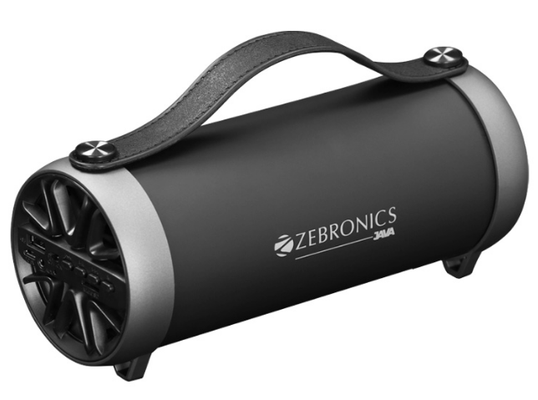
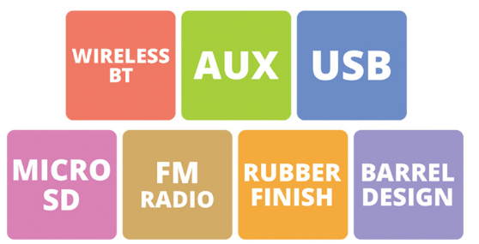
Portable BT Speaker
ZEB-JAVA
Features
Specification
Wireless BT
Supports USB/ Micro SD card
Built-in FM Radio
AUX Input
Media / volume control
Built-in Rechargeable battery
Output Power (RMS): 8W
BT Version: 2.1
Driver Size: 2.5"
Speaker Impedance: 4Ω
Frequency Response: 100Hz - 16kHz
S/N Ratio: ≥65dB
Max Supported USB/Micro SD memory size: 32GB
Supported Audio formats: MP3
Charging time: 3hrs
Playback time: 2hrs(max volume)
Product Dimension (W x D x H): 240 x 94 x 105 mm
Net. Weight: 608g
MRP: ₹1899

Slide 31
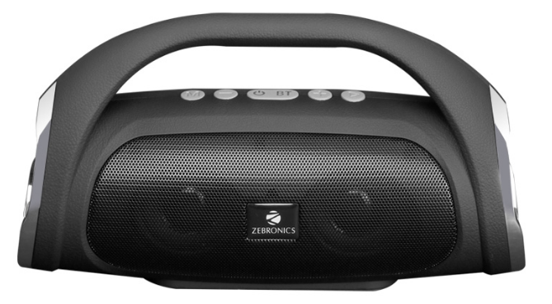
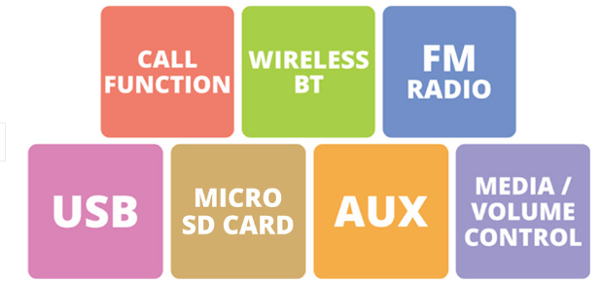
Portable BT Speaker
ZEB-SPLASH
Features
Specification
Wireless BT
Supports USB & Micro SD card
Built-in FM Radio
AUX Input
Media control
Dual Speaker
Call Function
Built-in Rechargeable Battery
Output Power (RMS): 3W x 2
BT Version: 4.2
Driver Size: 50mm x 2
Speaker Impedance: 4Ω
Frequency Response: 100Hz - 20kHz
S/N Ratio: ≥65dB
Separation: ≥55dB
Max Supported USB/Micro SD memory size: 32GB
Supported Audio formats: MP3
Charging time: 3hrs
Playback time: 3-4hrs*
Product Dimension (W x D x H): 198 x 75 x 115 mm
Package Dimension (W x D x H): 130 x 84 x 207 mm
Net. Weight: 450g
MRP: ₹1999

Slide 32
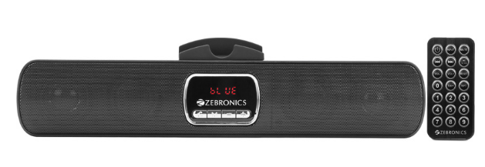
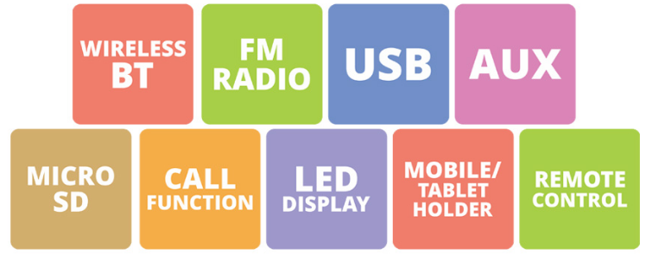
Portable BT Speaker
ZEB-OLIVER
Features
Specification
Wireless BT
Supports USB & mSD card
Built-in FM Radio
AUX Input
Call Function
Media / Volume control
LED Display
Built-in Rechargeable battery
Remote Control
Mobile/Tablet holder
Output Power (RMS): 6W (3W + 3W)
BT Version: 2.1
Driver Size: 40mm x 2
Speaker Impedance: 4Ω
Frequency Response: 180Hz-20kHz
S/N Ratio: ≥80dB
Separation: ≥75dB
Max Supported USB/mSD memory size: 32GB
Supported Audio formats: MP3
Charging time: 1 -2 hrs
Playback time: 2-3 hrs
Product Dimension (W x D x H): 281 x 39 x 69 mm (with mobile holder)
Net. Weight: 356g
MRP: ₹1999

Slide 33
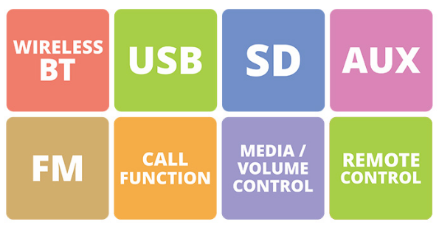
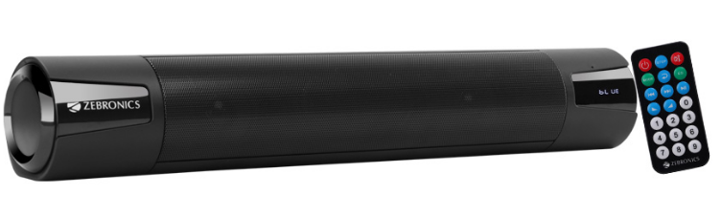
Portable BT Speaker
ZEB-ASTRA
Features
Specification
Wireless BT
Supports USB & SD card
Built-in FM Radio
AUX Input
Media/Volume control
Call Function
Remote Control
Built-in Rechargeable Battery
Output Power (RMS): 15W (7.5W + 7.5W )
BT Version: 2.1+EDR
Driver Size: 2" x 2
Speaker Impedance: 3Ω
Frequency Response: 100Hz-18kHz
S/N Ratio: ≥68dB
Separation: ≥45dB
Max Supported USB & SD memory size: 32GB
Supported Audio formats: MP3
Charging time: 2-3 hrs
Playback time: 3 hrs
Product Dimension (W x Dia): 405 x 65mm
Net. Weight: 468g
MRP: ₹2999

Slide 34
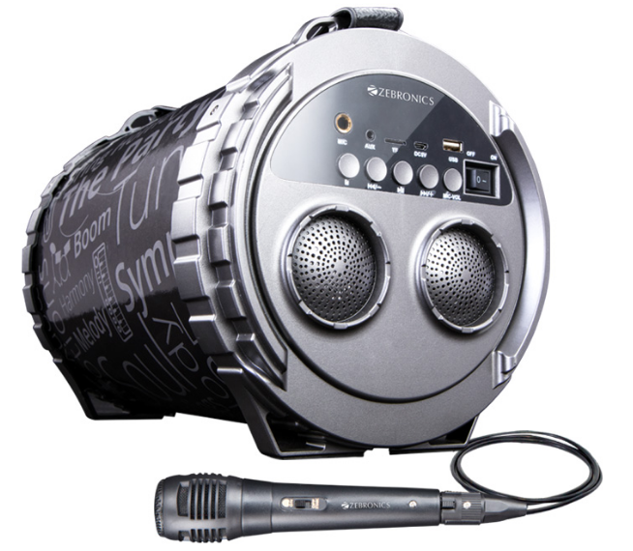
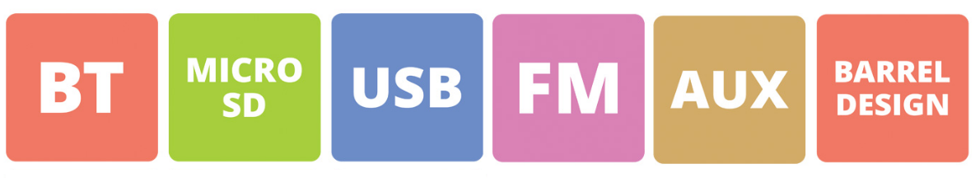
Portable BT Speaker
ZEB-SUPER BAZOOKA
Features
Specification
Wireless BT
Supports USB/ Micro SD card
Built-in FM Radio
AUX Input
RGB Light
Media / volume control
Built-in Rechargeable Battery
Karaoke function
Output Power (RMS): 15W
BT Version: 2.1+EDR
Driver Size: 6.5 " + 2 "
Speaker Impedance: 3Ω + 4 Ω
Frequency Response: 100Hz - 20kHz
S/N Ratio: ≥85dB
Max Supported USB/mSD memory size: 32GB
Supported Audio formats: MP3
Charging time: 4-5 hrs
Playback time: 2 hrs
Product Dimension (W x D x H):210 x 320 x 225 mm
Net. Weight: 1.9kg
MRP: ₹3999

Slide 35
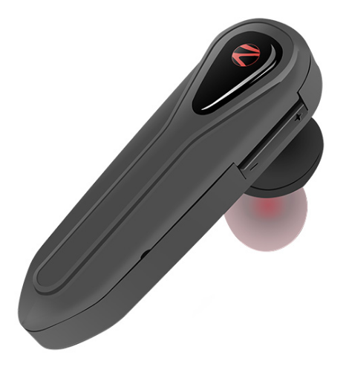
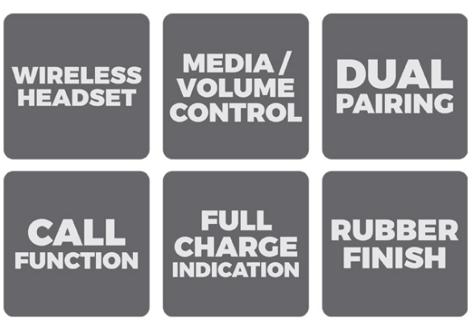
BT Headset
ZEB-COOL 10
Features
Specification
Wireless BT
Volume/Media Control
Dual Pairing
Built-in Rechargeable Battery
Full Charge Indication
BT Version: 4.2
Supported BT Profile: HSP,HFP,A2DP,AVRCP
Playback Time: 2 hours
Charging Time: 1 hours
Talk Time: 3 hours
Standby Time: 60 hours
Product Dimension (W x D x H):16 x 25.5 x 54.50 mm
Package Dimension (W X D X H): 65 x 32 x 185 mm
Net Weight: 8g
MRP: ₹499

Slide 36
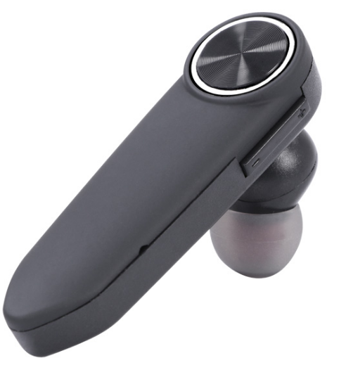

BT Headset
ZEB-COOL 20
Features
Specification
Wireless BT
Volume/Media Control
Dual Pairing
Built-in Rechargeable Battery
Full Charge Indication
BT Version: 4.2
Supported BT Profile: HSP,HFP,A2DP,AVRCP
Playback Time: 2 hours
Charging Time: 1 hours
Talk Time: 3 hours
Standby Time: 60 hours
Product Dimension (W x D x H): 17 x 25.50 x 54.70 mm
Package Dimension (W X D X H): 65 x 32 x 185 mm
Net Weight: 8g
MRP: ₹499

Slide 37


BT Headset
ZEB-PREKSHA
Features
Specification
Wireless BT Headset
Voice Assistant Support
Full Charge Indication
Splash proof
Call Function
Additional 8 hours battery life with Charging Case*
Built-In Rechargeable Battery
BT Version: 4.1
Supported BT Profile: HSP / HFP / A2DP / AVRCP
Drive Size: 6mm
Speaker Impedance: 16Ω
Playback Time: 4hrs*
Charging Time
Earphone: 2hrs
Case : 2.5hrs
Talk Time: 4hrs*
Standby Time: 15 days
Case Dimension (W x D x H): 76.5 x 28 x 31.5 mm
Package Dimension (W X D X H): 76 x 48 x 125 mm
Net Weight: 35g
MRP: ₹1999

Slide 38


BT Earphone With Mic
ZEB-BE380T
Features
Specification
Wireless BT
Volume/Media Control
Dual Pairing
Full Charge Indication
Call Function
Built-In Rechargeable Battery
Supports Micro SD Card
BT Version: 4.2
Supported BT Profile: A2DP, AVRCP, HSP, HFP
Drive Size: 10mm
Speaker Impedance: 16Ω
Max supported Micro SD memory size: 32GB
Playback Time: 3-4 hours
Charging Time: 1-2 hours
Talk Time: 3-4 hours
Standby Time: 10 hours
Controller Dimension (W x D x H): 67 x 20.5 x 18.5 mm
Net Weight: 20g
MRP: ₹999

Slide 39



BT Earphone With Mic
ZEB-SYMPHONY
Features
Specification
Wireless BT Earphone with Neckband
Volume/Media Control
Dual Pairing
Magnetic Earpiece
Splash proof
Full Charge Indication
Call Function
Voice Assistant support
Built-In Rechargeable Battery
BT Version: 5.0
Supported BT Profile: HFP / HSP / A2DP / AVRCP
Drive Size: 10mm
Speaker Impedance: 16Ω
Playback Time: 13hrs*
Charging Time: 2.5hrs
Talk Time: 15hrs
Standby Time: 15 days
Package Dimension (W x D x H): 158 x 30 x 202 mm
Net Weight: 24g
MRP: ₹1199

Slide 40


BT Earphone With Mic
ZEB-STYLE
Features
Specification
Wireless BT earphone with Neckband
Voice Assistant support
Volume/Media Control
Dual Pairing
Magnetic Earpiece
Full Charge Indication
Call Function
Vibration alert for calls
Built-In Rechargeable Battery
BT Version: 4.2
Supported BT Profile: HSP / HFP / A2DP / AVRCP
Drive Size: 10mm
Speaker Impedance: 16Ω
Playback Time: 6.5hrs*
Charging Time: 2hrs
Talk Time: 6.5hrs*
Standby Time: 2-3 days
Package Dimension: 174 x 34 x 196 mm
Net Weight: 40g
MRP: ₹1399

Slide 41


BT Earphone With Mic
ZEB-JOURNEY
Features
Specification
Wireless BT earphone with Neckband
Volume/Media Control
Dual Pairing
Magnetic Earpiece
Splash proof
Full Charge Indication
Call Function
Vibration alert for calls
Voice Assistant support
Built-In Rechargeable Battery
BT Version: 4.1
Supported BT Profile: HSP / HFP / A2DP / AVRCP
Drive Size: 10mm
Speaker Impedance: 16Ω
Playback Time=: 13 hours*
Charging Time: 2 hours
Talk Time: 10 hours
Standby Time: 15 days
Package Dimension: 168 x 234 x 30 mm
Net Weight: 36g
MRP: ₹1999

Slide 42


True Wireless Earphone
ZEB-PEACE
Features
Specification
Wireless Stereo Sound
Additional 6 hour battery life with Charging Case
Voice Assistant Support
Each earphone can be used individually
Full Charge Indication
Splash proof
Call Function
Built-In Rechargeable Battery
BT Version: 4.1
Supported BT Profile: HSP / HFP / A2DP / AVRCP
Drive Size: 6mm
Speaker Impedance: 16Ω
Playback Time: 2 hrs 30 mins
Charging Time
Earphone: 2 hours
Case: 2 hrs 30 mins
Talk Time: 2 hrs 30 mins
Standby Time: 24 hrs
Case Dimension (W x D x H): 60 x 26.5 x 40 mm
Net Weight: 44 g
MRP: ₹3999

Slide 43


BT Headphone with Mic
ZEB-THUNDER
Features
Specification
Wireless BT
Supports Micro SD
AUX Function
Built-in FM Radio
Soft & Comfortable Earcups
Adjustable Headband
Media/Volume control
Call Function
Built-in Rechargeable Battery
BT version: 5.0
Wireless range: 10 meters (Without obstacles)
Driver Size: 40mm
Speaker Impedance: 32Ω
Frequency Response: 40Hz - 20kHz
Sensitivity: 105dB
Charging time: 2.5hrs
Playback time: 9hrs*
Standby time: 200hrs
Talk time: 12hrs
Microphone Impedance: 1.2kΩ
Microphone Sensitivity:-40dB±1dB
Package Dimension: 156 x 82 x 195mm
Net. Weight: 142g
MRP: ₹1199

Slide 44


BT Headphone with Mic
ZEB-REGAL
Features
Specification
Wireless BT
Voice assistant support
Supports Micro SD
AUX Function
Built-in FM Radio
Soft & Comfortable Ear Cushions
Adjustable Headband
Media/Volume control
Call Function
Built-in Rechargeable Battery
BT version: 4.2
Wireless range: 10 meters (Without obstacles)
Driver Size: 40mm
Speaker Impedance: 32Ω
Frequency Response: 20Hz - 20kHz
Sensitivity: 105dB+3dB
Charging time: 2hrs
Playback time: 9hrs*
Talk time: 9hrs*
Microphone Impedance: 1.2kΩ
Microphone Sensitivity: -42dB±3dB
Package Dimension: 190 x 230 x 80 mm
Net. Weight: 188g
MRP: ₹2499

Slide 45


Wired Headphone with Mic
ZEB-BUZZ
Features
Specification
Compatible for Mobile/Tablet
Adjustable Headband
Foldable Earcups
Call Function
Volume Control
Driver Size : 40mm
Speaker Impedance: 32Ω
Frequency Response: 20Hz-20kHz
Sensitivity: 105dB+3dB
Microphone Impedance: 1.2KΩ
Microphone Sensitivity: -42dB
Connector type: 3.5mm Jack
Cable length: 1.5m
Net. Weight: 132g
MRP: ₹549

Slide 46


Wired Headphone with Mic
ZEB-STORM
Features
Specification
Compatible for Mobile/Tablet
Adjustable Headband
Foldable Earcups
Call Function
Driver Size : 40mm
Speaker Impedance: 32Ω
Frequency Response: 20Hz-20kHz
Sensitivity: 105dB+3dB
Microphone Impedance: 1.2KΩ
Microphone Sensitivity: -42 ± 3dB
Connector type: 3.5mm
Cable length: 1.5m
Net. Weight: 148g
Package Dimension (W x D x H): 165 x 75 x 175 mm
MRP: ₹699

Slide 47


Wired Headphone with Mic
ZEB-SHADOW
Features
Specification
Compatible for Mobile/Tablet
Adjustable Headband
Comfortable Cushions
Flat Cables
Call Function
Driver Size: 40mm
Speaker Impedance: 32Ω
Frequency Response: 20Hz-20kHz
Sensitivity: 115dB +3dB
Microphone Impedance: 2.2kΩ ±30% at 1KHz
Microphone Sensitivity: -42dB ± 3dB
Connector type: 3.5mm
Cable length: 1.2m
Package Dimensions (W x D x H): 178 x 81 x 206mm
Net. Weight: 148g
MRP: ₹849

Slide 48


Wired Earphone with Mic
ZEB-EM900
Features
Specification
In-line Microphone
Strong and long lasting cable
Tangle Free Cable
Light Weight
Drive Size: 10mm
Impedance: 16 ohms
Frequency response: 20Hz-20kHz
Sensitivity: 103dB ± 3dB
Connector: 3.5mm Jack
Cable length: 1.2m
Net weight: 12g
MRP: ₹299

Slide 49


Wired Earphone with Mic
ZEB-EMZ10
Features
Specification
MRP: ₹299
In-line Microphone
Strong and long lasting cable
Tangle Free Cable
Light Weight
Drive Size: 10mm
Impedance: 16Ω
Frequency response: 20Hz-20kHz
Sensitivity: 100dB ± 3dB
Connector: 3.5mm Jack
Cable length: 1.2m
Net weight: 14g

Slide 50


Wired Earphone with Mic
ZEB-TEMPTATION
Features
Specification
In-line Microphone
Stylish Design
Tangle Free Cable
Strong and long lasting cable
Drive Size: 10mm
Impedance: 16Ω
Frequency response: 20Hz-20kHz
Sensitivity: 105dB
Connector: 3.5mm
Cable length: 1.2m
Package Dimension (W x D x H): 66 x 20 x 185 mm
Net weight: 14g
MRP: ₹599

Slide 51


USB Cable
ZEB-UMC100
Features
MRP: ₹190
USB to Micro USB Cable
Supports upto 2A
Charge & Sync
Strong & Long lasting cable
1 Meter long Cable

Slide 52


USB Cable
ZEB-UCC100
Features
MRP: ₹325
USB to Type C cable
Supports upto 2A
Charge & Sync
Strong & Long lasting cable
1 Meter long Cable

Slide 53


USB Cable
ZEB-ULC100
MRP: ₹340
Features
USB to Lightning Cable
Supports upto 2A
Charge & Sync
Strong & Long lasting cable
1 Meter long Cable

Slide 54


USB Cable
ZEB-ULC100S
Features
MRP: ₹440
USB to Lightning Cable
Supports upto 2A
Charge & Sync
Strong & Long lasting sleeved cable
1 Meter long Cable

Slide 55


USB Cable
ZEB-UMLCC120
Features
USB to Lightning, Type-C & Micro USB Cable
Supports upto 2A
Charge
Strong & Long lasting Cable
1.2 Meter long Cable
MRP: ₹1049

Slide 56


USB Cable
ZEB-UMC120A
Features
USB to Micro USB Cable
Supports upto 5A
Charge & Sync
Metal Sleeved Cable
1.2 Meter Long Cable
MRP: ₹649

Slide 57


USB Cable
ZEB-UCC120A
Features
MRP: ₹749
USB to Type C USB Cable
Supports upto 5A
Charge & Sync
Metal Sleeved Cable
1.2 Meter Long Cable

Slide 58


USB Cable
ZEB-ULC120A
Features
MRP: ₹749
USB to Lightning Cable
Supports upto 5A
Charge & Sync
Metal Sleeved Cable
1.2 Meter Long Cable

Slide 59


Mobile USB Charger
ZEB-MA511
Features
Specification
1A Output
1 USB port
Over Current, Over voltage and short circuit Protection
Less Ripple
High Efficiency
Auto Self Recovery
Input Voltage: 100-240Vac, 50/60Hz
Max Output Current: 5V 1A
No. Of USB Ports: 1
Materials: Plastic
Dimension (W x D x H): 42.5 x 25 x 40 mm
Weight: 32g
MRP: ₹249

Slide 60


Mobile USB Charger
ZEB-MA522
Features
Specification
2.1A Output
Dual USB port
Over Current, Over voltage and short circuit Protection
Less Ripple
High Efficiency
Auto Self Recovery
Input Voltage: 100-240Vac, 50/60Hz
Max Output: 5V 2.1A
No. Of USB Ports: 2
Materials: Plastic
Dimension ( W x D x H): 47 x 31 x 48 mm
Weight: 42g
MRP: ₹349

Slide 61


Car Charger
ZEB-CC242A2
Features
Specification
Compact Design
Over Current, Over voltage and Over temperature Protection
Short circuit Protection
Dual USB Ports
Input Voltage: DC 12V - 24V
Output 1: DC 5V - 2.4A
Output 2: DC 5V - 2.4A
(total 2.4A max)
Material: ABS Plastic
Product Dimension (W x D x H): 24 x 75 x 30 mm
Package Dimension (W x D x H): 91 x 33 x 131 mm
Net weight: 22.3g
MRP: ₹299

Slide 62


Car Charger
ZEB-CC242A3
Features
Specification
Compact Design
Over Current, Over voltage and Over temperature Protection
Short circuit Protection
LED Indicator
Dual USB Ports
Input Voltage: DC 12V - 24V
Output 1: DC 5V - 2.1A
Output 2: DC 5V - 2.1A
(total 2.1A max)
Material: ABS Plastic
Product Dimension (W x D x H): 25 x 64.75 x 35 mm
Package Dimension (W x D x H): 69 x 30 x 110 mm
Net weight: 18g
MRP: ₹299

Slide 63


Car Charger
ZEB-CC312AL1
Features
Specification
Compact Design
LED Display
Over Current, Over voltage and Over temperature Protection
Short circuit Protection
Dual USB Ports
Input Voltage: DC 12V - 24V
Output 1: DC 5V - 3.1A
Output 2: DC 5V - 3.1A
(total 3.1A max)
Material: ABS Plastic + Aluminium
Product Dimension (W x D x H): 25 x 65 x 35 mm
Package Dimension (W x D x H): 74 x 25 x 115mm
Net weight: 22g
MRP: ₹699

Slide 64


Wireless Charger
ZEB-WCP500
Features
Specification
Stylish and portable design
LED indicator
Over Heat Protection
Over Current Protection
Over Voltage Protection
Short Circuit Protection
Input Power: DC5V 2A
Input Interface: Micro USB
Max. Output Power: 5V 1A
Charging Distance: Recommend 2-4mm, Max:10mm
Product Dimension (Dia x H): 68 x 12 mm
Net Weight: 35g
MRP: ₹899

Slide 65

Wireless Charger
ZEB-WCP1000S
Features
Specification
Stylish and portable design
LED indicator
FOD Function
Fast Charge
Over Heat Protection
Over Current Protection
Over Voltage Protection
Short Circuit Protection
Input Power: DC5V 2A, DC9V - 1.67A
Input Interface: Micro USB
Max. Output Power: 5V 1A , 9V 1.2A
Charging Distance: Recommended 2-4mm, Max:10mm
Product Dimension (Dia x H): 68 x12 mm
Net Weight: 34 g
MRP: ₹1099

Slide 66


Wireless Charger
ZEB-WCS1000S
Features
Specification
Stylish and portable design
LED indicator
Dual Coils
FOD Function
Fast Charge
Over Heat Protection
Over Current Protection
Over Voltage Protection
Short Circuit Protection
Input Power: DC5V 2A, DC9V - 1.67A
Input Interface: Micro USB
Max. Output Power: 5V 1A , 9V 1.2A
Charging Distance: Recommend 3-8mm, Max:10mm
Product Dimension (W x D x H): 70.5 x 87 x113 mm
Net Weight: 92g
MRP: ₹1299

Slide 67


Optical USB Mouse
ZEB-POWER
Features
Specification
Compact and stylish design
Advanced optical sensor technology
High precision
Plug & Play
Interface: USB
Total No. of buttons: 3
Sensor: Optical
Max. Power Consumption: 5V, 100mA
Resolution: 1200DPI
Keystrokes Life: 3 Million cycles
Cable Length: 1.2 Meters
Dimension (W x D x H): 58 x 98 x 31 mm
Net. Weight: 52g
MRP: ₹199

Slide 68


Optical USB Mouse
ZEB-DLM10
Features
Specification
Stylish & Ergonomic design
Advanced Optical Sensor Technology
High Precision
Smooth Operation
Works on Most Surfaces
Gold Plated USB with copper wire
Plug & Play
Interface: USB
Total No. of buttons: 4
Sensor: Optical
Power Consumption: 5V, 100mA
Resolution: 800/1000/1200 DPI
Key strokes Life: 3 millions
Cable Length: 1.8 Meters
Dimension (W x D x H): 58 x 110 x 37 mm
Net. Weight: 97g
MRP: ₹999

Slide 69


Wireless Mouse
ZEB-ROLLO
Features
Specification
2.4GHz Stable wireless connection
Receiver can be hidden in the mouse shell
Nano receiver
Smart energy saving Mode
Works on most surfaces
Plug and play
Interface: USB (Nano Receiver)
Resolution: 800/1200/1600 DPI
No. of Buttons: 4
Battery Required: 2 x AAA Batteries
Button life: 3 Million Cycles
Wireless Range: 10 meter (without obstacles)
Product Dimension (W x D x H): 64 x 96.5 x 36 mm
Dongle dimension (W x D x H): 14 x 6 x 18.5 mm
Dongle weight: 2g
Net Weight: 45g
MRP: ₹549

Slide 70


Wireless Mouse
ZEB-AQUA
Features
Specification
2.4GHz Stable wireless connection
Smart energy-saving mode
Receiver can be hidden in the mouse jack
Works on most surfaces
Nano receiver
Plug and play
Interface: USB (Nano Receiver)
Resolution: 1200 DPI
No. of Buttons: 3
Battery Required: 1 x AA Battery
Button life: 3 Million Cycles
Wireless Range: 10 meter (without obstacles)
Product Dimension (W x D x H): 62.5 x 113 x 31 mm
Dongle Dimension (W x D x H): 14 x 6 x 18.5 mm
Dongle weight: 2g
Net Weight: 62g
MRP: ₹599

Slide 71


Wireless Keyboard & Mouse Combo
ZEB-COMPANION 103
Features
Specification
Keyboard
Interface: USB (Nano Receiver)
Total No. of Keys: 104 nos
Total No. of Hotkeys: 12 nos (Integrated)
Battery Required: 1 x AAA Battery
Keystrokes life: 80 Million Cycles
Wireless Range: 6-8 meters
Dimension (W x D x H): 450 x 150 x 21.30 mm
Net Weight: 474g
Mouse
Interface: USB (Nano Receiver)
Resolution: 800/1200/1600 DPI
No. of Buttons: 6
Battery Required: 1 x AA Battery
Button life: 2.5 Million cycles
Wireless Range: 6-8 meters
Product Dimension (W x D x H): 61.25 x 98.5 x 35 mm
Net Weight: 60g
Keyboard
UV coated keys
Integrated Multimedia Keys
Low battery LED indication
Rupee Key
Power Saving Mode
Mouse
Compact & Ergonomic Design
Plug and play
Navigation keys on side panel
High Precision
Nano receiver holder in the mouse
Solid structure
High quality buttons
MRP: ₹1299

Slide 72


Wireless Keyboard & Mouse Combo
ZEB-COMPANION 106
Features
Specification
Keyboard
Mini size keyboard
Multimedia Keys
On/Off Switch
Comfortable and silent
Power Saving Mode
UV coated keycaps
Mouse
Ultra-thin design
Advanced Optical Sensor Technology
On/Off switch
Power Saving Mode
Keyboard
Interface USB(Nano receiver)
Total No. of Keys: 90
Total No. of Hotkeys: 6
Battery Required: 2 x AAA Battery
Keystrokes life: 1 Million cycles
Wireless Range: 10 meter (without obstacles)
Product Dimension (W x D x H): 271 x 150 x 18.7 mm
Net Weight: 300g
Mouse
Interface: USB (Nano Receiver)
Resolution: 800 / 1200 / 1600 DPI
No. of Button: 4
Battery Required: 1 x AA Battery
Button life: 3 Million cycles
Wireless Range: 10 meter (without obstacles)
Product Dimension (W x D x H): 57 x 113.3 x 25.3 mm
Net Weight: 50g
MRP: ₹999

Slide 73


Keyboard & Mouse Combo
ZEB-JUDWAA 580
Features
Specification
Keyboard
Dedicated Hotkeys
New chocolate keycaps design
Comfortable & Silent
Mouse
Ergonomic design
3 buttons with scroll wheel
Accurate optical sensor
Keyboard
Interface: USB
Total No. of Keys: 113
Total No. of Hotkeys: 6
Cable Length: 1.2 Meters
Dimension (W x D x H): 403 x 128 x 26 mm
Net. Weight: 382g
Mouse
Interface: USB
Total No. of buttons: 3
Sensor: Optical
Power Consumption: Details NA
Resolution: 1200 DPI
Cable Length: 1.2 Meters
Dimension (W x D x H): 69.75 x 104 x 36.75 mm
Net. Weight: 62g
MRP: ₹549

Slide 74


USB Keyboard
ZEB-K25
Features
Specification
Standard keyboard
Super slim design
Spill-proof
Comfortable and silent
Interface: USB
Total No. of Keys: 105
Power Consumption: DC 5V, <36mA
Keystrokes life: 1million
Cable Length: 1.2 Meters
Product Dimension (W x D x H): 410 x 116 x 21 mm
Package Dimension (W x D x H): 445 x 123 x 27 mm
Net. Weight: 334 g
MRP: ₹399

Slide 75


USB Keyboard
ZEB-DLK01 (Black)
Features
Specification
Comfortable and tactile
12 Integrated Multimedia keys
Chiclet keys
Slim Design
Interface: USB
Total No. of Keys: 104
Multimedia Keys: 12 (Integrated)
Power Consumption: 5V, <100mA
Keystrokes life: 80 Million
Cable Length: 1.8 meters
Dimension (W x D x H)(w/o stand): 450 x 151 x 21.5 mm
Package Dimension: 472 x 35 x 78 mm
Net. Weight: 488g
MRP: ₹499

Slide 76

USB Keyboard
ZEB-DLK01 (White)
Features
Specification
Comfortable and tactile
12 Integrated Multimedia keys
Chiclet keys
Slim Design
Interface: USB
Total No. of Keys: 104
Multimedia Keys: 12 (Integrated)
Power Consumption: 5V, <100mA
Keystrokes life: 80 Million
Cable Length: 1.8 meters
Dimension (W x D x H)(w/o stand): 450 x 151 x 21.5 mm
Package Dimension: 472 x 35 x 78 mm
Net. Weight: 488g
MRP: ₹599

Slide 77


2.0 Computer Speaker
ZEB-FAME
Features
Specification
2.0 Channel Speaker
USB Powered
Volume control
Output Power (RMS): 2.5 Watts + 2.5 watts
Drivers: 5.2cm (2.04") x 2
Impedance: 4Ω
Frequency response: 180Hz-20kHz
S/N Ratio: ≥75dB
Separation: ≥75dB
Line input: 3.5mm jack
Product Dimension (W x D x H): 89 x 65 x 112 mm
Package Dimension (W x D x H): 185 x 80 x 122 mm
Net. Weight: 412g
MRP: ₹799

Slide 78


2.1 Speaker
ZEB-ROCK SMART PLUS
Features
Specification
2.1 Channel Speaker
BT/USB/SD/FM/AUX
7.62 cm (3") Subwoofer
Power indicator LED
Output Power (RMS):
Subwoofer - 5 watts
Satellite - 3 watts x 2
Total -11 watts
Driver Size:
Subwoofer -7.62 cm (3") x 1
Satellite -6.35 cm (2.5") x 2
S/N Ratio: ≥ 68dB
Separation: ≥ 65dB
Line input: 3.5mm Jack
FM frequency range: 87 MHz - 108 MHz
BT version: 4.2
Product Dimension (W x D x H):
Subwoofer -210 x 137 x 120 mm
Satellite -85 x 113 x 140 mm
Net. Weight: 1.31kg
MRP: ₹1999

Slide 79


2.1 Speaker
ZEB-CRYSTAL 2 BTRUF
Features
Specification
MRP: ₹3499
2.1 channel speaker
BT/USB/AUX/FM
LED display
LED Lights
Volume, Bass & Treble adjustment
Remote control
Wall mountable
Output Power (RMS):
Subwoofer - 20 watts
Satellite - 10 watts x 2
Total -40 watts
Driver Size:
Subwoofer -10.16 cm (4") x 1
Satellite -7.62 cm (3") x 2
S/N Ratio: ≥ 80dB
Separation: ≥ 45dB
Line input: 2ch RCA
FM frequency range: 87.5 MHz - 108 MHz
BT version: 4.0
Product Dimension (W x D x H):
Subwoofer -150 x 278 x 208 mm
Satellite -107 x 88 x 126 mm
Net. Weight: 3.38kg

Slide 80


2.1 Speaker
ZEB-CLAW 2 BTRUCF
Features
Specification
2.1 Channel Speaker
BT/USB/SD/AUX/FM
LED display
13.33 cm (5.25") Subwoofer
Remote control
Output Power (RMS):
Subwoofer - 25 watts
Satellite - 10 watts x 2
Total -45 watts
Driver Size:
Subwoofer -13.33 cm (5.25") x 1
Satellite -7.62 cm (3") x 2
S/N Ratio: ≥ 72dB
Separation: ≥ 45dB
Line input: 2ch RCA
FM frequency range: 87.5 MHz - 108 MHz
BT version: 4.2
Product Dimension (W x D x H):
Subwoofer -175 x 300 x 265 mm
Satellite -100 x 100 x 165 mm
Net. Weight: 4.03kg
MRP: ₹4199

Slide 81


2.1 Speaker
ZEB-OMEGA 2 BTRUCF
Features
Specification
2.1 Channel Speaker
BT/USB/SD/AUX/FM
LED display
13.33 cm (5.25") Subwoofer
Remote control
Output Power (RMS):
Subwoofer - 20 watts
Satellite - 10 watts x 2
Total -40 watts
Driver Size:
Subwoofer -10.16 cm (4") x 1
Satellite -7.62 cm (3") x 2
S/N Ratio: ≥ 72dB
Separation: ≥ 45dB
Line input: 2ch RCA
FM frequency range: 87 MHz - 108 MHz
BT version: 4.2+EDR
Product Dimension (W x D x H):
Subwoofer -160 x 270 x 240 mm
Satellite -90 x 92 x 143 mm
Net. Weight: 3.05kg
MRP: ₹2999

Slide 82


2.1 Speaker
ZEB-PRISTINE 2 BTRUCF
Features
Specification
2.1 Channel Speaker
BT/USB/SD/FM/AUX
LED display
RGB Strip
12.7 cm (5") Subwoofer
Volume, Bass & Treble Adjustment
Remote control
Output Power (RMS):
Subwoofer - 25 watts
Satellite - 10 watts x 2
Total -45 watts
Driver Size:
Subwoofer -12.7 cm (5") x 1
Satellite -7.62 cm (3") x 2
S/N Ratio: ≥ 72dB
Separation: ≥ 45dB
Line input: 2ch RCA
FM frequency range: 87 MHz - 108 MHz
BT version: 4.2+EDR
Product Dimension (W x D x H):
Subwoofer -200 x 286 x 207 mm
Satellite -100 x 102 x 153 mm
Net. Weight: 4.5kg
MRP: ₹4199

Slide 83


4.1 Speaker
ZEB-FEEL BTRUCF
Features
Specification
4.1 channel speaker
BT/USB/SD/AUX/FM
10.16 cm (4") subwoofer
Remote control
Output Power (RMS):
Subwoofer - 20 watts
Satellite - 10 watts x 4
Total -60 watts
Driver Size:
Subwoofer -10.16 cm (4") x 1
Satellite -6.35 cm (2.5") x 2
S/N Ratio: ≥ 68dB
Separation: ≥ 45dB
Line input: 2ch RCA
FM frequency range: 87 MHz - 108 MHz
BT version: 2.1+EDR
Product Dimension (W x D x H):
Subwoofer -150 x 257 x 230 mm
Satellite -90 x 76 x 145 mm
Net. Weight: 2.9kg
MRP: ₹3499

Slide 84


4.1 Speaker
ZEB-ZEN 4
Features
Specification
MRP: ₹4399
4.1 channel speaker
BT/USB/SD/FM/AUX
LED Display
Color changing LED Lights
12.7 cm (5") subwoofer
Remote control
Volume & bass adjustment
Output Power (RMS):
Subwoofer - 20 watts
Satellite - 10 watts x 4
Total -60 watts
Driver Size:
Subwoofer -12.7 cm (5") x 1
Satellite -7.62 cm (3") x 4
S/N Ratio: ≥ 72dB
Separation: ≥ 45dB
Line input: 2ch RCA
FM frequency range: 87 MHz - 108 MHz
BT version: 4.2+EDR
Product Dimension (W x D x H):
Subwoofer -150 x 280 x 265mm
Satellite -95 x 90 x 153 mm
Net. Weight: 4.3kg

Slide 85


4.1 Speaker
ZEB-ELECTRO BTRUCF
Features
Specification
4.1 channel speaker
BT/USB/SD/AUX/FM
12.7 cm (5") subwoofer
Remote control
Volume & Bass adjustment
Output Power (RMS):
Subwoofer - 20 watts
Satellite - 10 watts x 4
Total -60 watts
Driver Size:
Subwoofer -12.7 cm (5") x 1
Satellite -10.16 cm (4") x 4
S/N Ratio: ≥ 72dB
Separation: ≥ 45dB
Line input: 2ch RCA
FM frequency range: 87 MHz - 108 MHz
BT version: 4.2+EDR
Product Dimension (W x D x H):
Subwoofer -204 x 210 x 206mm
Satellite -125 x 80 x 130 mm
Net. Weight: 3.5kg
MRP: ₹4699

Slide 86


4.1 Speaker
ZEB-CLAW 4 BTRUCF
Features
Specification
MRP: ₹4999
4.1 Channel Speaker
Wireless BT/USB/SD/AUX/FM
LED display
13.33 cm (5.25") Subwoofer
Remote control
Output Power (RMS):
Subwoofer - 25 watts
Satellite - 10 watts x 4
Total -65 watts
Driver Size:
Subwoofer -13.33 cm (5.25") x 1
Satellite -7.62 cm (3") x 4
S/N Ratio: ≥ 72dB
Separation: ≥ 45dB
Line input: 2ch RCA
FM frequency range: 87.5 MHz - 108 MHz
BT version: 4.2
Product Dimension (W x D x H):
Subwoofer -175 x 300 x 265 mm
Satellite -100 x 100 x 165 mm
Net. Weight: 4.9kg

Slide 87


4.1 Speaker
ZEB-PRISTINE 4 BTRUCF
Features
Specification
4.1 Channel Speaker
BT/USB/SD/FM/AUX
LED display
RGB Strip
12.7 cm (5") Subwoofer
Volume, Bass & Treble Adjustment
Remote control
Output Power (RMS):
Subwoofer - 25 watts
Satellite - 10 watts x 4
Total -65 watts
Driver Size:
Subwoofer -12.7 cm (5") x 1
Satellite -7.62 cm (3") x 4
S/N Ratio: ≥ 72dB
Separation: ≥ 45dB
Line input: 2ch RCA
FM frequency range: 87 MHz - 108 MHz
BT version: 4.2+EDR
Product Dimension (W x D x H):
Subwoofer -200 x 286 x 207 mm
Satellite -100 x 102 x 153 mm
Net. Weight: 5.5kg
MRP: ₹4999

Slide 88


4.1 Speaker
ZEB-JELLY FISH BTRUCF
Features
Specification
4.1 channel speaker
BT/USB/SD/AUX/FM
LED Display
White/Blue LED lights
13.3 cm (5.25") subwoofer
Remote control
Glossy Finish
Output Power (RMS):
Subwoofer - 25 watts
Satellite - 12 watts x 4
Total -73 watts
Driver Size:
Subwoofer -13.3 cm (5.25") x 1
Satellite -7.62 cm (3") x 4
S/N Ratio: ≥ 72dB
Separation: ≥ 45dB
Line input: 2ch RCA
FM frequency range: 87 MHz - 108 MHz
BT version: 4.2+EDR
Product Dimension (W x D x H):
Subwoofer -175 x 301 x 275 mm
Satellite -116 x 105 x 168 mm
Net. Weight: 5.2kg
MRP: ₹5399

Slide 89


4.1 Speaker
ZEB-INDIE BTRUCF
Features
Specification
4.1 channel speaker
Wireless BT/USB/SD /AUX/FM
LED display
LED light on satellites
Rhythmic LED light on subwoofer
16.51 cm (6.5") subwoofer
Remote control
Volume, bass & treble adjustment.
Output Power (RMS):
Subwoofer - 45 watts
Satellite - 15 watts x 4
Total -105 watts
Driver Size:
Subwoofer -16.51 cm (6.5") x 1
Satellite -7.62 cm (3") x 4
S/N Ratio: ≥ 72dB
Separation: ≥ 45dB
Line input: 2ch RCA
FM frequency range: 87 MHz - 108 MHz
BT version: 4.2+EDR
Product Dimension (W x D x H):
Subwoofer -218 x 372 x 324 mm
Satellite -116 x 101 x 324 mm
Net. Weight: 8.5kg
MRP: ₹7299

Slide 90


5.1 Speaker
ZEB-BT6590RUCF
Features
Specification
5.1 channel speaker
BT/USB/SD/Aux/FM/5.1
LED display
Stylish design
10.16cm (4") subwoofer
Remote control
Output Power (RMS):
Subwoofer - 35 watts
Satellite - 6 watts x 5
Total -65 watts
Driver Size:
Subwoofer -10.16 cm (4") x 1
Satellite -6.98 cm (2.75") x 5
S/N Ratio: ≥ 75dB
Separation: ≥ 50dB
Line input: 2ch RCA, AC-3
FM frequency range: 87.5 MHz - 108 MHz
BT version: 2.1+EDR
Product Dimension (W x D x H):
Subwoofer -140 x 280 x 275 mm
Satellite -90 x 80 x 132 mm
Net. Weight: 4.51kg
MRP: ₹4999

Slide 91


5.1 Speaker
ZEB-TAAL BTRUCF
MRP: ₹10199
Features
Specification
5.1 channel speaker
Wireless BT/USB/SD/FM/AUX/AC-3
LED display
20.32cm (8") subwoofer
Remote control
Output Power (RMS):
Subwoofer - 45 watts
Satellite - 10 watts x 5
Total -95 watts
Driver Size:
Subwoofer -20.32 cm (8") x 1
Satellite -7.62 cm (3") x 5
S/N Ratio: ≥ 68dB
Separation: ≥ 45dB
Line input: 2ch RCA, AC-3
FM frequency range: 87.5 MHz - 108 MHz
BT version: 2.1+EDR
Product Dimension (W x D x H):
Subwoofer - 231 x 382 x 384 mm
Satellite -125 x 124 x 227 mm
Net. Weight: 12kg

Slide 92

Trolley Speaker
ZEB-100 MOVING MONSTER x8L
Features
Specification
Wireless BT / USB / Micro SD / FM / AUX / Mic Input
Karaoke with Recording function
LED display
LED lights with On/Off switch
20.32cm (8") full range speaker
Remote control
Wireless MIC
Built-in rechargeable battery
Volume & Bass controls
Driver Size
Full range - 20.32cm(8") x 1
Tweeter - 2.54cm(1") x 1
Impedance
Full range - 3Ω
Tweeter - 6Ω
Frequency response: 80Hz-18kHz
S/N Ratio: ≥60dB
Line input: 3.5mm
FM frequency range: 87.5 MHz - 108 MHz
Charging time : 3hrs
Playback time: 5.8 hrs*
BT version: 4.2
Product Dimension (W x D x H): 264 x 210 x 413 mm
Net. Weight: 2.9kg
MRP: ₹6499

Slide 93

Sound Bar
ZEB-JUKE BAR 3
Features
Specification
Sound bar with subwoofer
Wireless BT/USB/SD/FM/AUX/TV IN
13.33cm (5.25") Subwoofer
Remote control
Wall Mountable
LED Display
Quad drives
Volume/Media Control
Class D Amp
Lower power consumption
Output Power (RMS)
Subwoofer - 25 watts
Satellite - 10 watts x 2
Total - 45 watts
Driver Size
Subwoofer - 13.33cm (5.25") x 1
Satellite - 7cm x 4cm (2.75" x 1.5") x 4
Frequency response: 35Hz-20kHz
S/N Ratio: ≥68dB
Separation: ≥45dB
File format support (USB/SD): MP3
Line input: 3.5mm
Max supported memory size (USB/SD): 32GB
FM frequency range: 87.5MHz - 108MHz
BT version: 2.1 + EDR
Net. Weight
Subwoofer - 3.19kg
Soundbar - 1.13kg
Total - 4.5kg
MRP: ₹7999

Slide 94


Slide 95


Slide 96


Slide 97

A responsible brand
ZEB HEALTH
A healthier you - Conducting health campaigns where one can come and ensure a healthy living.
ZEB ENVIRONMENT - Nurturing growth
Nurturing the growth of environment and keeping the surroundings clean initiative.
ZEB TECH - Sharing is Learning
A Platform given to the students to bring out the best in them and prepare them for challenging future.
ZEB-LEARN - Spreading smiles, Discovering wisdom
Helping Homes, Orphanages and NGOs to create an environment of optimism and help them in their growth

Slide 98


Slide 99


Slide 100


Slide 101


Slide 102

Marketing
Hoarding
Newspapers
Shop branding
TV
360
Approach
Cricket
degree
Dealer meet
Magazine
Co-branding
Road show
Cultural
Online
Expo
Social media

Slide 103


Slide 104


Slide 105


Slide 106


Slide 107


Slide 108


Slide 109


Slide 110


Slide 111


Slide 112


Slide 113


Slide 114


Slide 115


Slide 116


Slide 117


